Slide 1

CHAPTER 2:
DISPLAY HARDWARE

Slide 2
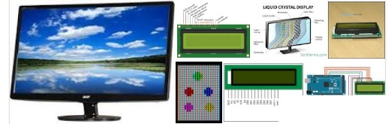
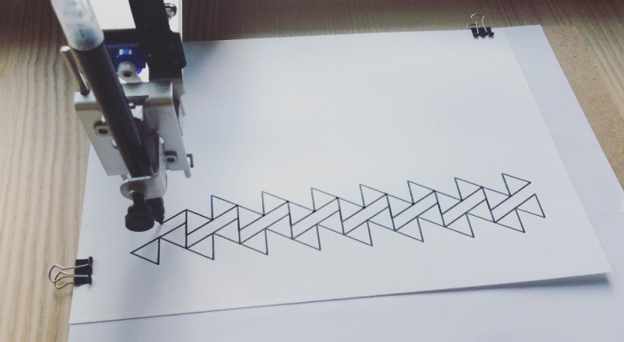
DISPLAY HARDWARE
Video Display Devices
  Cathode Ray Tube (CRT)
  Liquid Crystal Display (LCD)
  Plasma panels
  Light-emitting diodes (LED)
Hard-Copy Devices
  Ink-jet printer
  Laser printer
  Pen plotter

Slide 3
Cathode Ray Tube (CRT)
Characterized by:
Evacuated glass bottle
Extremely high voltage
Heating element
Vertical and horizontal deflection plates
Beam that strikes phosphor coating on front of tube

Slide 4
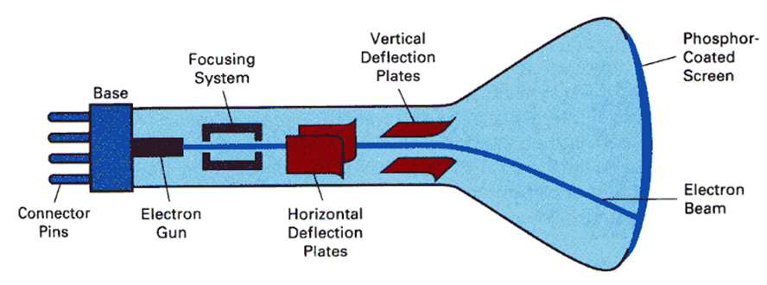
Cathode Ray Tube (CRT)
CRT stands for Cathode ray tube. It is a technology which is used in traditional computer monitor and television.
A beam of electrons, emitted by an electron gun, passes through focusing and deflection systems that direct the beam toward specified positions on the phosphor-coated screen.
To maintain the phosphor glow, the picture is redrawn repeatedly by quickly directing the electron beam back over the same screen points.

Slide 5
Component of CRT
Electron Gun: The electron gun is made up of several elements, mainly a heating filament (heater) and a cathode. The electron gun is a source of electrons focused on a narrow beam facing the CRT.
Focusing & Accelerating Anodes: These anodes are used to produce a narrow and sharply focused beam of electrons.
Horizontal & Vertical Deflection Plates: These plates are used to guide the path of the electron the beam. The plates produce an electromagnetic field that bends the electron beam through the area as it travels.
Phosphorus-coated Screen: The phosphorus coated screen is used to produce bright spots when the high-velocity electron beam hits it.

Slide 6
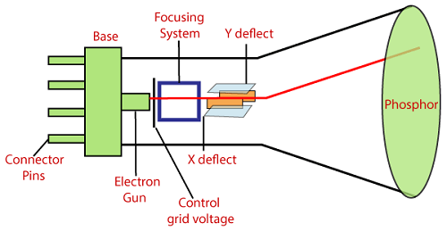
CATHODE-RAY TUBE (CRT)

Slide 7
CATHODE-RAY TUBE (CRT)
In monochrome CRT there is only one electron gun, whereas in a color CRT there are three electron guns each controlling the display of red, green and blue light, respectively. A color CRT monitor displays color pictures by using a combination of phosphors that emit different colored light.

Slide 8
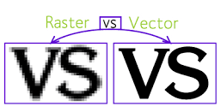
CRTS - DISPLAY MODELS
There are two main type of models: Raster and Vector.
Raster graphics are created with pixel-based programs or captured with a camera or scanner.
Vector graphics are created with vector software and are commonly used for logos, illustrations, CAD, and engineering.

Slide 9
RASTER (BITMAP)
In a raster scan system, the electron beam is swept across the screen, one row at a time from top to bottom, covering one line at a time, to create a pattern of illuminated spots.
A raster scan is based on pixel intensity control display as a rectangular box on the screen called a raster.
Picture description is stored in the memory area called as Refresh buffer, or Frame Buffer.
Refreshing on raster scan displays is carried out at the rate 60 to 80 frame per second.

Slide 10
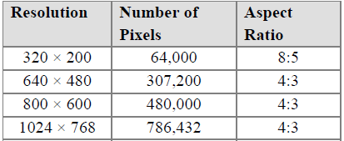
RASTER (BITMAP)
The quality of a raster image is determined by the total number pixels (resolution), and the amount of information in each pixel (color depth)
Resolution: maximum number of points that can be displayed without overlap
Pixel (picture element): each screen spot that can be illuminated by the electron beam
Aspect Ratio: the ratio of the number of X pixels to the number of Y pixels.

Slide 11
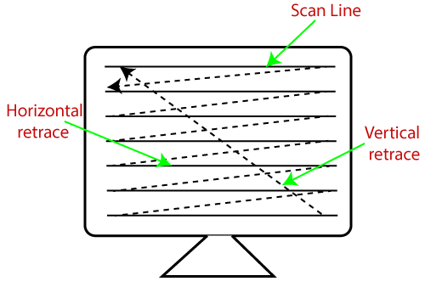
RASTER SCAN
The beam refreshing has two types:
Horizontal Retracing - The return of the beam direction to the leftmost position one line down
Vertical Retracing - When the beam starts from the top left corner and reaches bottom right, and again return to the top left, it is called the vertical retrace.

Slide 12
RASTER (BITMAP)
  Images are represented by dots (pixels)
  Raster-Scan Displays (e.g. TVs, monitors, printers)
  Resolution dependent (number of dots that can be displayed on the display device).
  Software: Photoshop, Paint Shop Pro
  File structures: BMP, JPG, PNG

Slide 13
REFRESH RATE
A phosphor material glows for a fraction of second when hit by electron beams and then fades making the image unstable (results in a flicker in the image). To make the screen stable, the image must be redrawn a number of times in a second.
In order to avoid flicker, the image should be redrawn quickly in such a way that our eyes cannot tell what is going on.
Refresh Rate – is the number of times per second that the screen is refreshed and is measured in Hertz (Hz).

Slide 14
PIXEL DEPTH
Pixel depth refers to the number of bits used to represent a pixel value.
1 bit/pixel:
0
2 Levels
(Bi-level image)
1
2 bits/pixel:
0
0
4 Levels
0
1
1
0
1
1
  1 bit per pixel produce 2 levels (bi-level image). 2 bits per pixel produce 4 levels. 8 bits per pixel produce 256 levels.
  In general, if the pixel depth is n, then it is possible to have 2^{n} levels

Slide 15
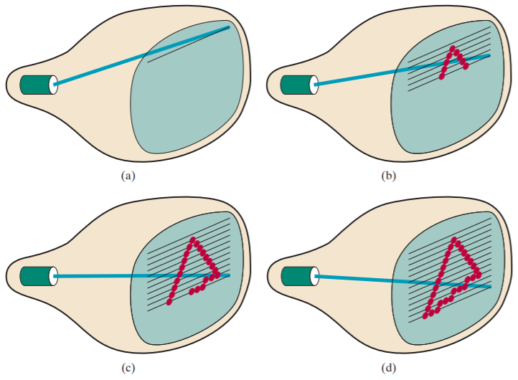
RASTER –SCAN DISPLAY

Slide 16
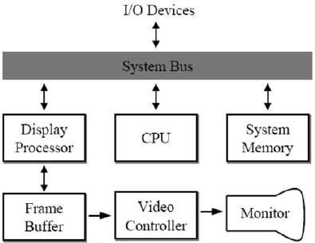
RASTER-SCAN DISPLAY PROCESSOR
Frame buffer: area in memory stores pictures (pixel values)
Video Controller: special purpose processor controls the operation of display device
The purpose of the display processor is to free the CPU from the graphics work.

Slide 17
FRAME BUFFER
Frame buffer is the video memory (RAM) that is used to hold or map the image displayed on the screen. It is a memory area which contains an internal representation of an image. It can be implemented as part of the main memory or as separate memory.
The amount of memory depends primarily on the resolution of the screen image and also the color depth used per pixel, i.e.
Memory in MB = (X-resolution × Y-resolution × bits-per-pixel) / (8 × 1024 × 1024)

Slide 18
RANDOM –SCAN DISPLAY (VECTOR)
Random scan display is the use of geometrical primitives such as points, lines, curves, and polygons, which are all based upon mathematical equation.
In a random scan display, a CRT has the electron beam directed only to the parts of the screen where a picture is to be drawn.
Vector images are mathematical calculations from one point to another that form lines and shapes. If you zoom into a vector graphic it will always look the same.

Slide 19
VECTORS
  Images are represented by sequence of commands or mathematical statements, a vector file is smaller than a corresponding bit-map.
  Random-Scan Displays (e.g. Plotters)
  Resolution independent
  Software: Adobe Illustrator, InkScape
  File structures: PDF, SVG

Slide 20
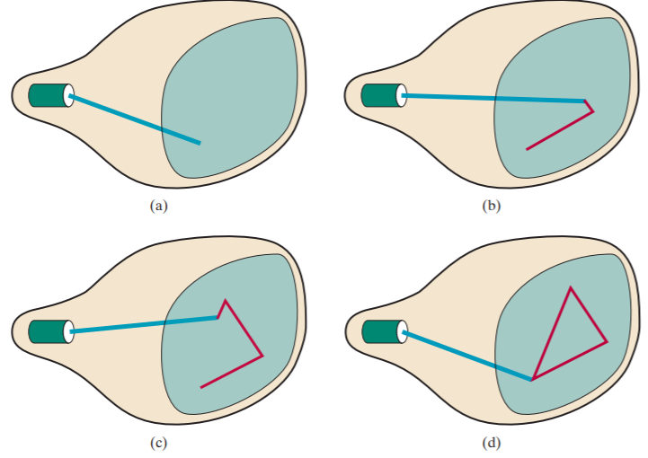
RANDOM –SCAN DISPLAY (VECTOR)

Slide 21
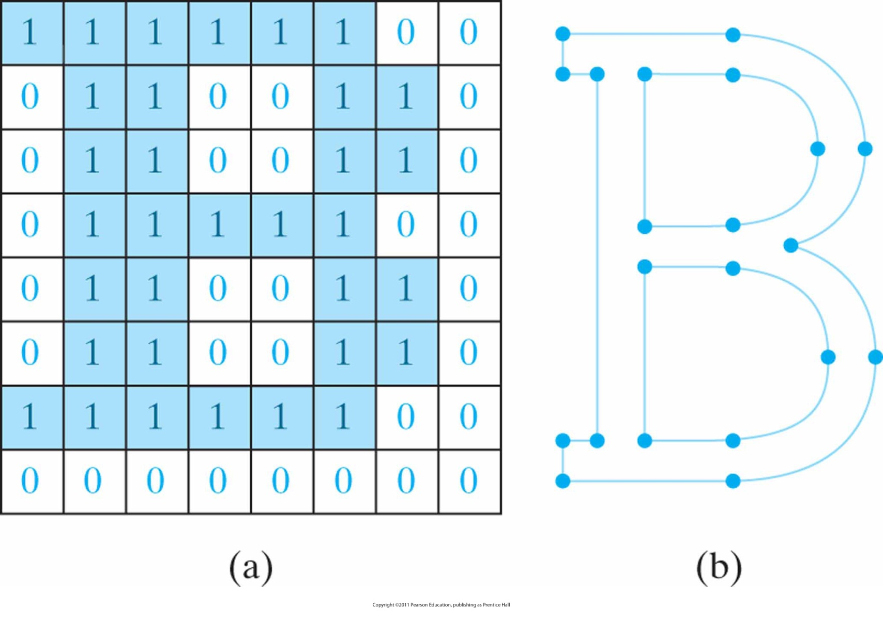
RASTER VS. VECTOR GRAPHICS

Slide 22
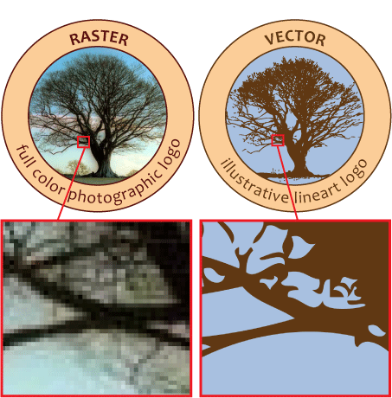

Slide 23
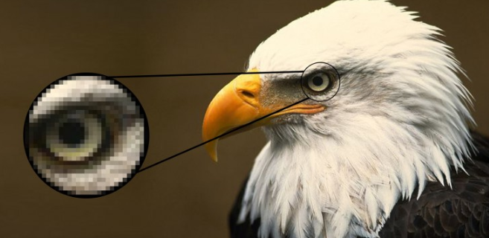
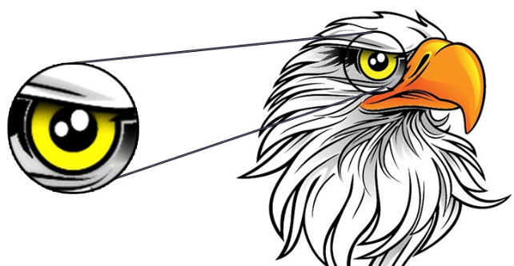
RASTER VS. VECTOR GRAPHICS

Slide 24
WHICH IS PREFERRED? RASTER/VECTOR
Raster programs best for editing photos and creating continuous tone images with soft color blends
Raster images are the most common image format, including: jpg, gif, png, tif, bmp, psd, and eps.
Common raster programs: photo editing / paint programs such as Photoshop & Paint Shop, GIMP

Slide 25
WHICH IS PREFERRED? RASTER/VECTOR
Do not scale up optimally. A raster image has a specific number of pixels. When you enlarge the image file without changing the number of pixels, the image will look blurry.
Large dimensions & detailed images equal large file size.
It is more difficult to print raster images using a limited amount of spot colors
Some processes cannot use raster formats

Slide 26
WHICH IS PREFERRED? RASTER/VECTOR
Vector programs best for creating logos, drawings and illustrations, technical drawings. For images that will be applied to physical products.
Can be scaled to any size without losing quality
Resolution-independent: Can be printed at any size/resolution
A large dimension vector graphic maintains a small file size
Number of colors can be easily increased or reduced to adjust printing budget

Slide 27
WHICH IS PREFERRED? RASTER/VECTOR
Vector art can be used for many processes and easily rasterized (converted to raster) to be used for all processes
Common vector graphic file format: ai, cdr, svg, and eps & pdfs originating from vector programs
Common vector programs: drawing programs such as Illustrator, CorelDraw, Inkscape
It is not the best format for continuous tone images with blends of color or to edit photographs

Slide 28
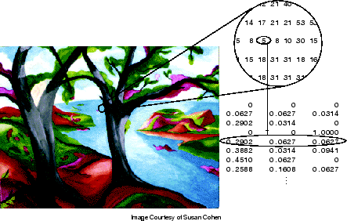
RASTER TYPES - INDEXED IMAGES
Consists of a data matrix (index) and a colormap matrix [0, 1].

Slide 29
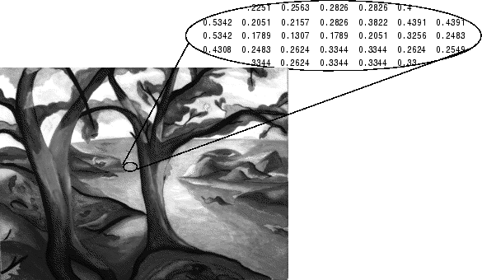
RASTER TYPES – INTENSITY IMAGES
Called grayscale image
Ranges between [0, 255] for 8-bits pixels

Slide 30
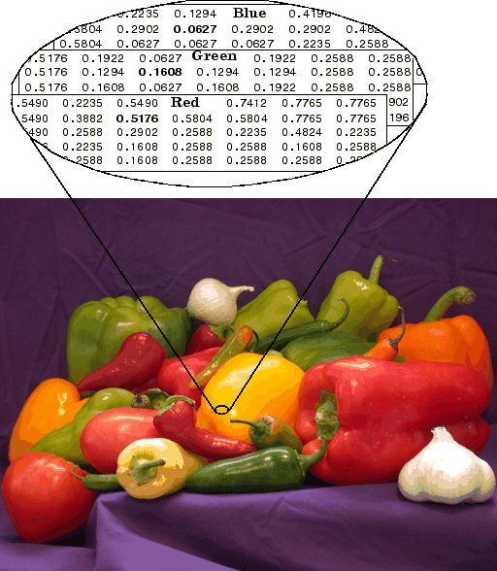
RASTER TYPES – RGB IMAGES
Called true-colour image, an m-by-n-by-3 data array that defines R (red), G (green), and B (blue) colour components for each pixel.

Slide 31
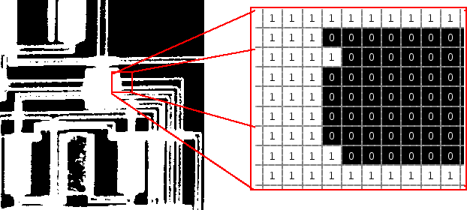
RASTER TYPES – BINARY IMAGES
Each pixel takes only one of only two values; on (white) and off (black)

Slide 32
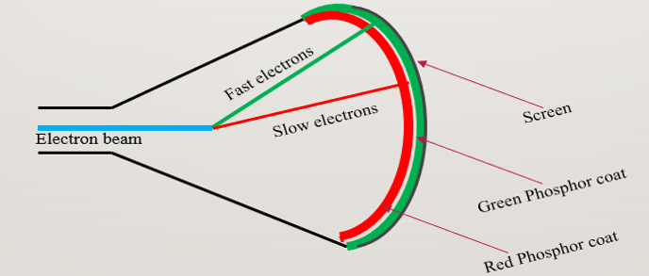
COLOR CRT MONITOR
The two basic color display producing techniques are:
Beam–Penetration Method

Slide 33
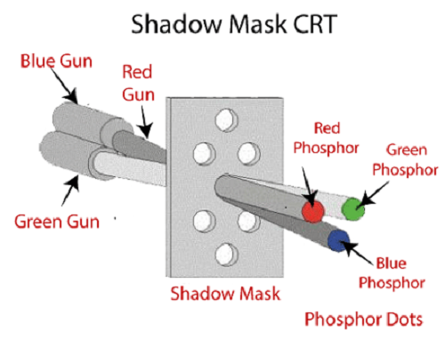
Shadow–Mask Method

Slide 34
End of Chapter

